Slide 1
USE-CASE 1
Setup Azure Devops CI CD pipeline for App Service Application & Deploy to Dev, QA and production Server.
Add Approver for every stage

Slide 2
Azure Devops Features
Azure Boards delivers a suite of Agile tools to support planning and tracking work, code defects, and issues using Kanban and Scrum methods.
Azure Repos provides Git repositories or Team Foundation Version Control (TFVC) for source control of your code.
Azure Pipelines provides build and release services to support continuous integration and delivery of your apps.
Azure Test Plans provides several tools to test your apps, including manual/exploratory testing and continuous testing.
Azure Artifacts allows teams to share Maven, npm, and NuGet packages from public and private sources and integrate package sharing into your CI/CD pipelines.

Slide 3
Steps for creationg CI/CD pipeine
Push the Sample Application to Repo
1. DevOps Portal → Create a Project (HelloWorldApp)
2. Project → Repo → Files → Copy Clone URL to Clipboard
3. D:\DevOpsDemos>git clone <Paste the URL>
4. D:\DevOpsDemos>dotnet new sln -o HelloWorldApp
5. D:\DevOpsDemos> cd HelloWorldApp
6. D:\DevOpsDemos\HelloWorldApp> dotnet new mvc -n HelloWorldApp.Web
7. D:\DevOpsDemos\HelloWorldApp> dotnet sln HelloWorldApp.sln add HelloWorldApp.Web\HelloWorldApp.Web.csproj
8. git add .
9. git commit -m "Initial Commit"
10. git push origin master

Slide 4
11. Switch back to the web portal and View the Committed Files.
Create a Pipeline
1. Pipeline → New Pipeline → Use the classic editor
2. Select your Source Code Repository and Branch → Continue
3. Select a Template: Select ASP.NET Core → Apply
4. This generates all the Tasks in a Job.
5. Click on Save and queue.
Enable Continuous Integration
Pipelines → Select Build Pipeline → Edit → Tab Triggers → Continuous integration → Enable continuous integration

Slide 5
Continous Deployment
Step1: Create an Azure App Service with Slots
Create an App Service = hw-Dev
Create an App Service = hw-QA
Create an App Service = hw-produ / Slot = Staging
Step2: Add Release Stage (QA)
Pipelines → Releases → +New → New release pipeline → Select Template Azure App Service Deployment → Apply
Change Stage name = Dev Stage
View Stage tasks: Click on 1 job, task, Select Azure Subscription = <Subscription created before>, App type = Web App on Windows, App service name = Demo
Check Deploy to App Service, App Service Name = new connection

Slide 6
Optional: Enable Continues deployment triggers:
Pipelines → Releases → Select Release Pipeline → Edit → In Artifacts Section click on Icon Continuous deployment trigger
In Continuous deployment trigger → Enabled
For example:
You want your build to be triggered by changes in master and most, but not all, of your feature branches.

Slide 7
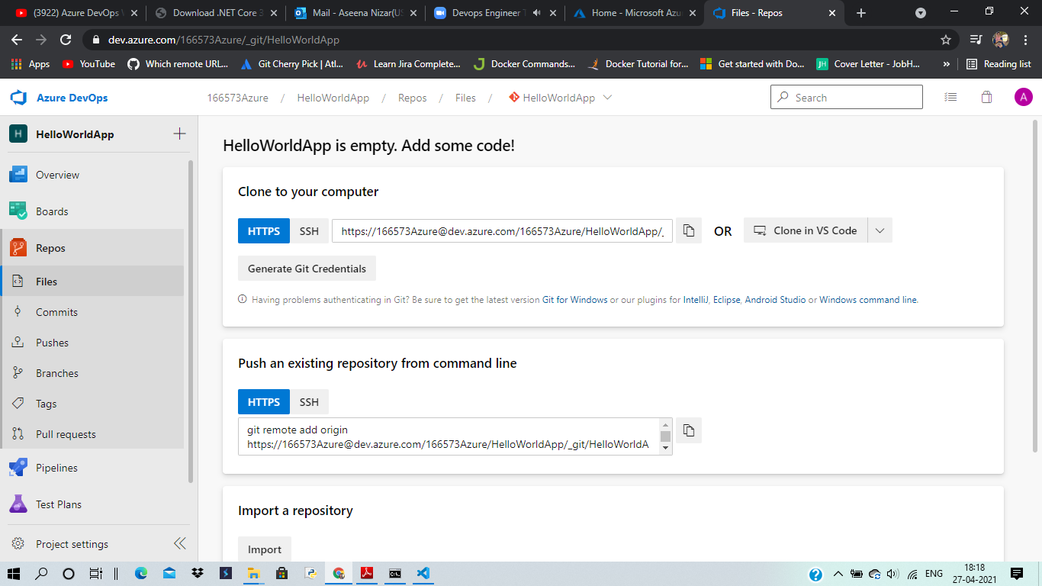

Slide 8
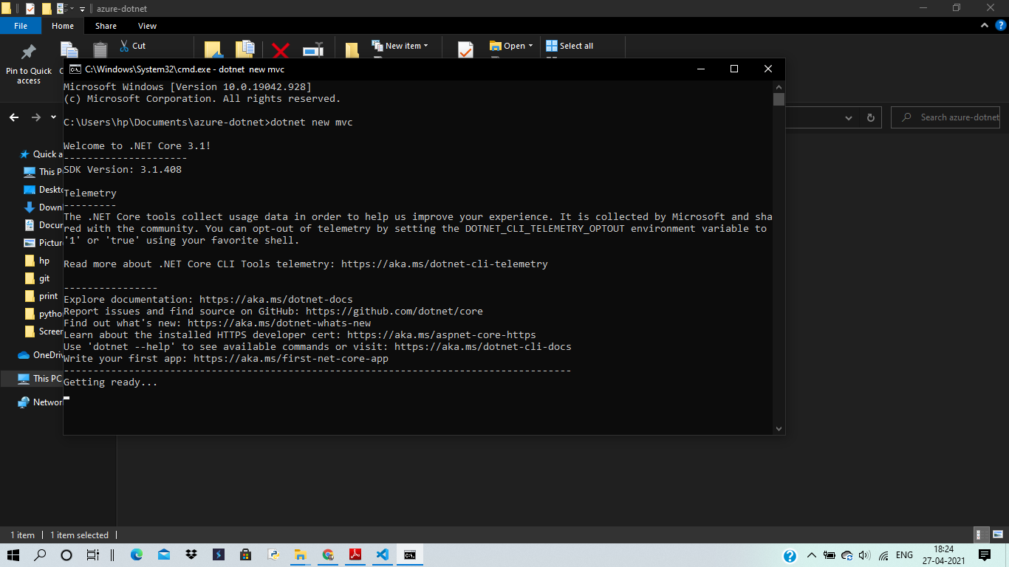

Slide 9
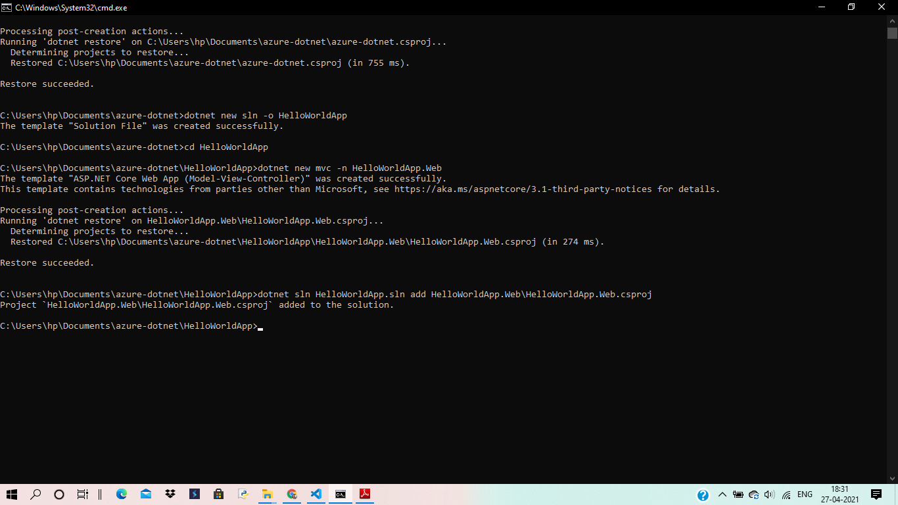

Slide 10
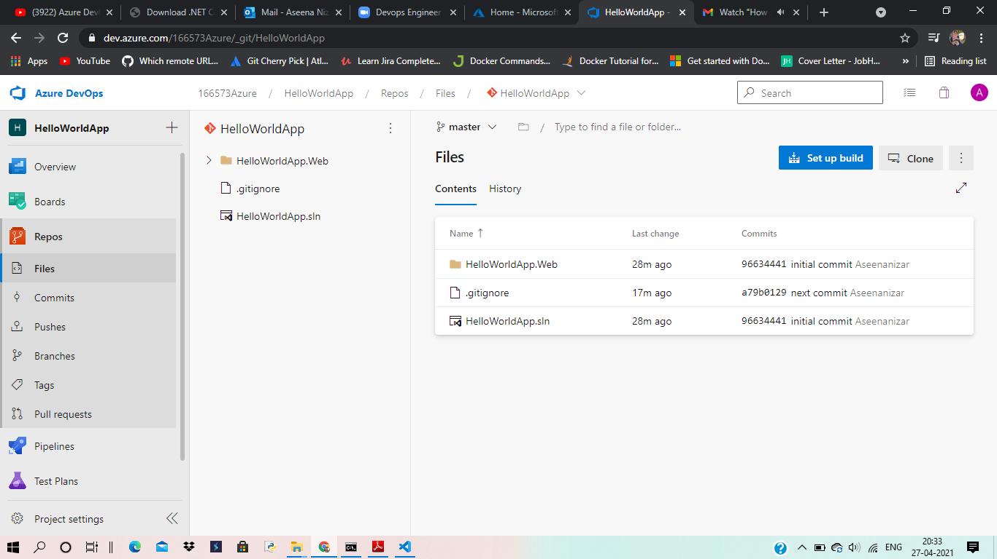

Slide 11
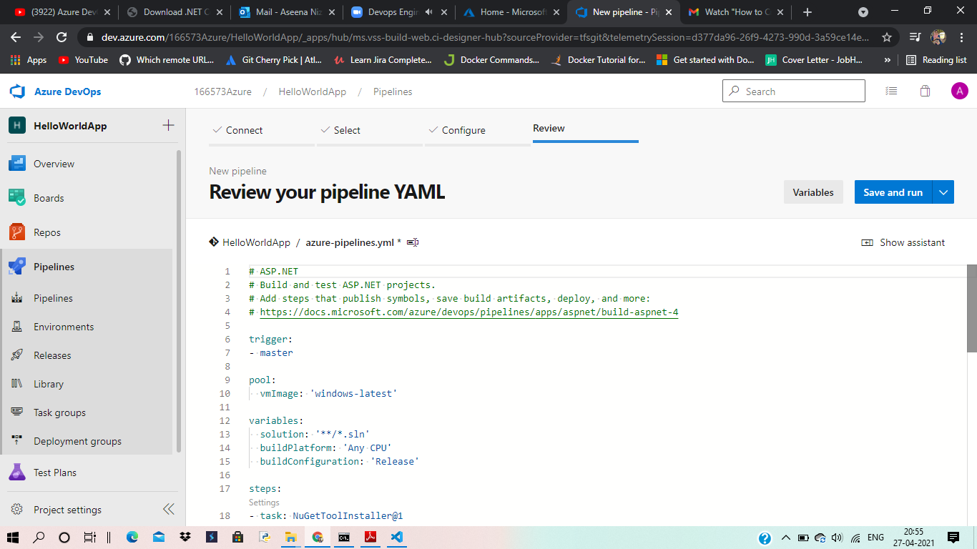

Slide 12
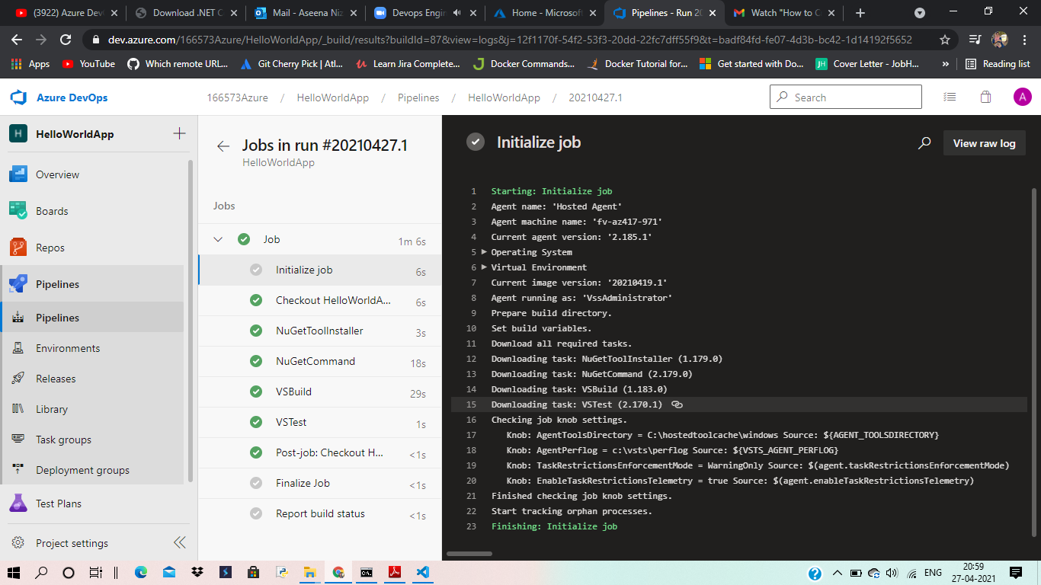

Slide 13
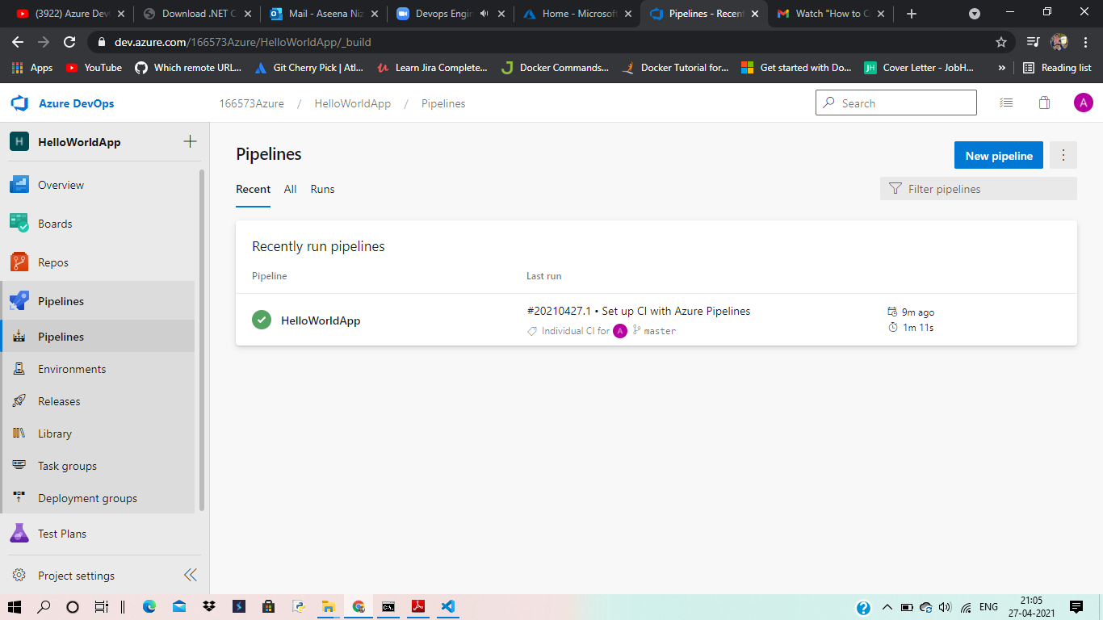

Slide 14
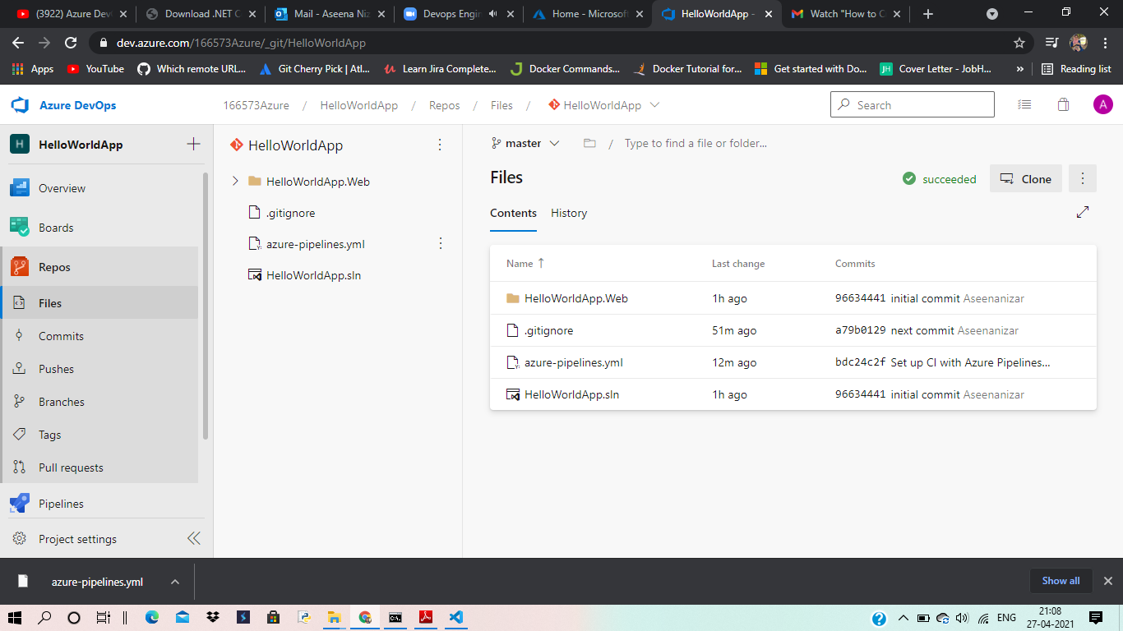

Slide 15
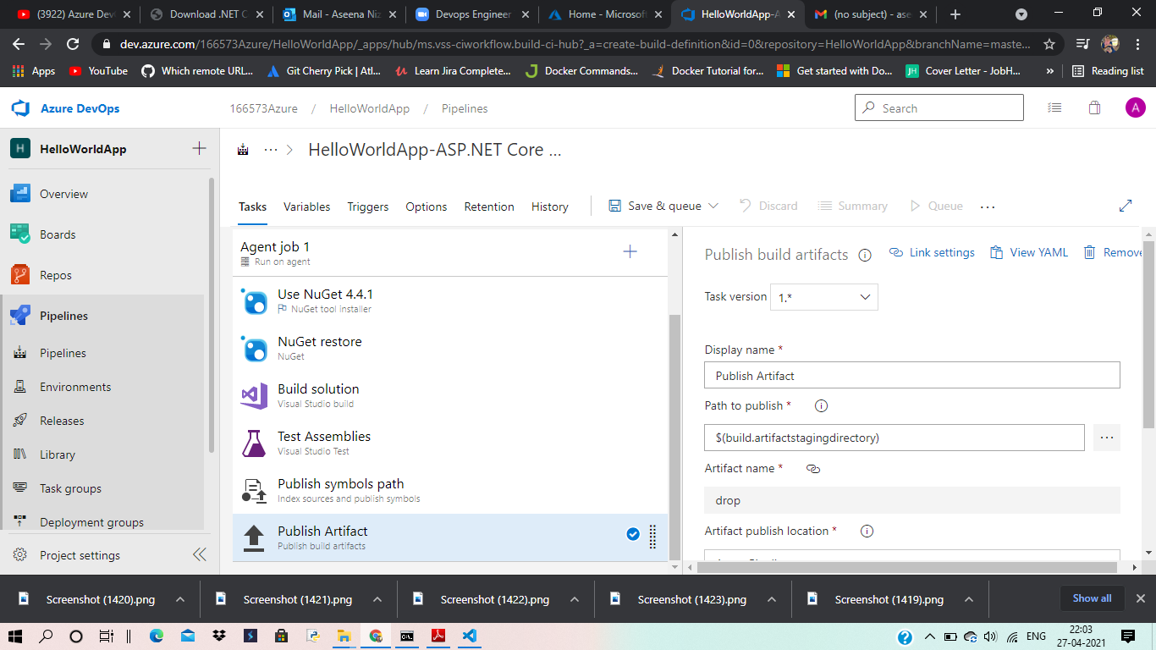

Slide 16
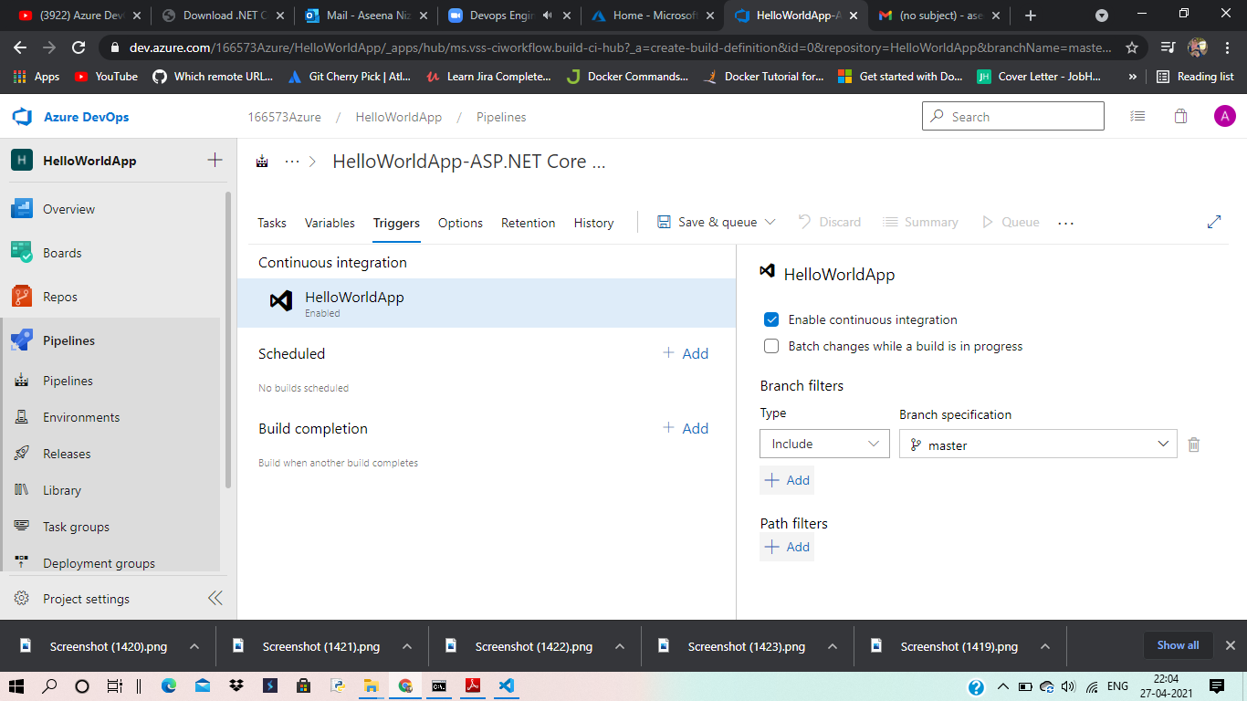

Slide 17
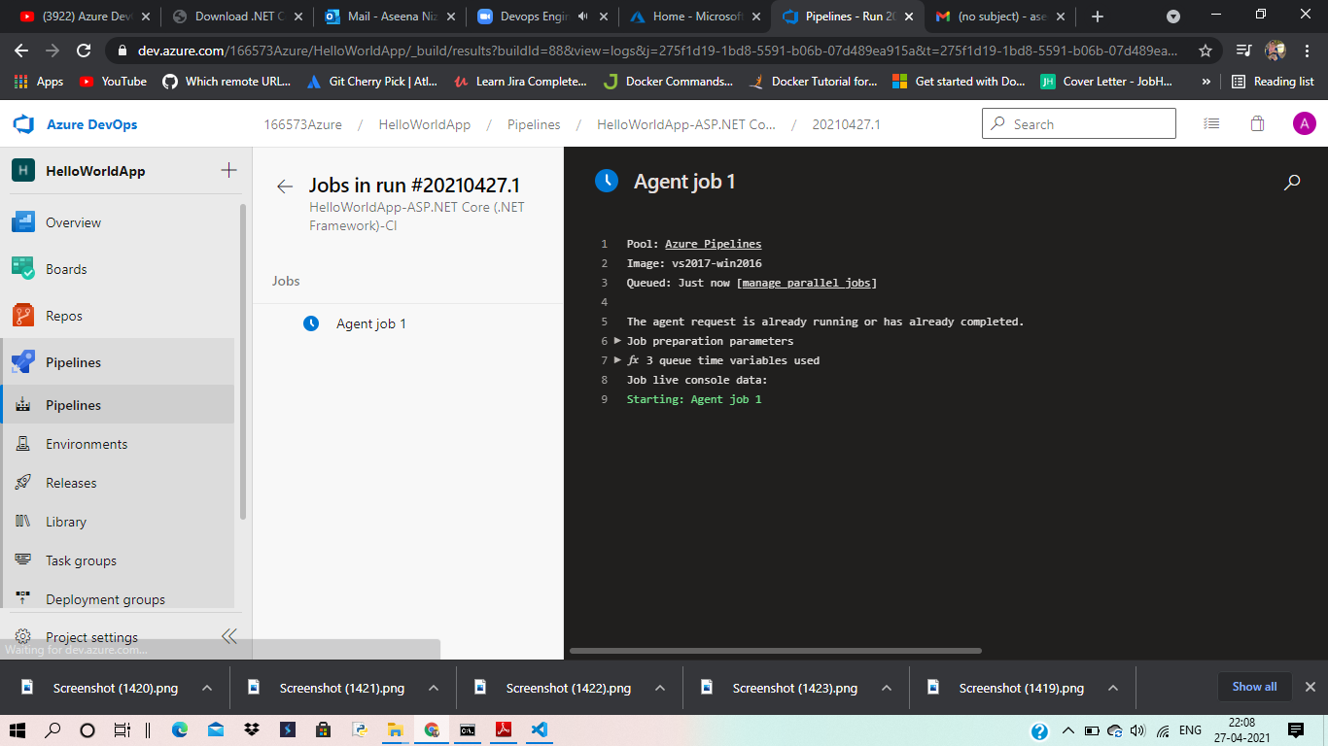

Slide 18
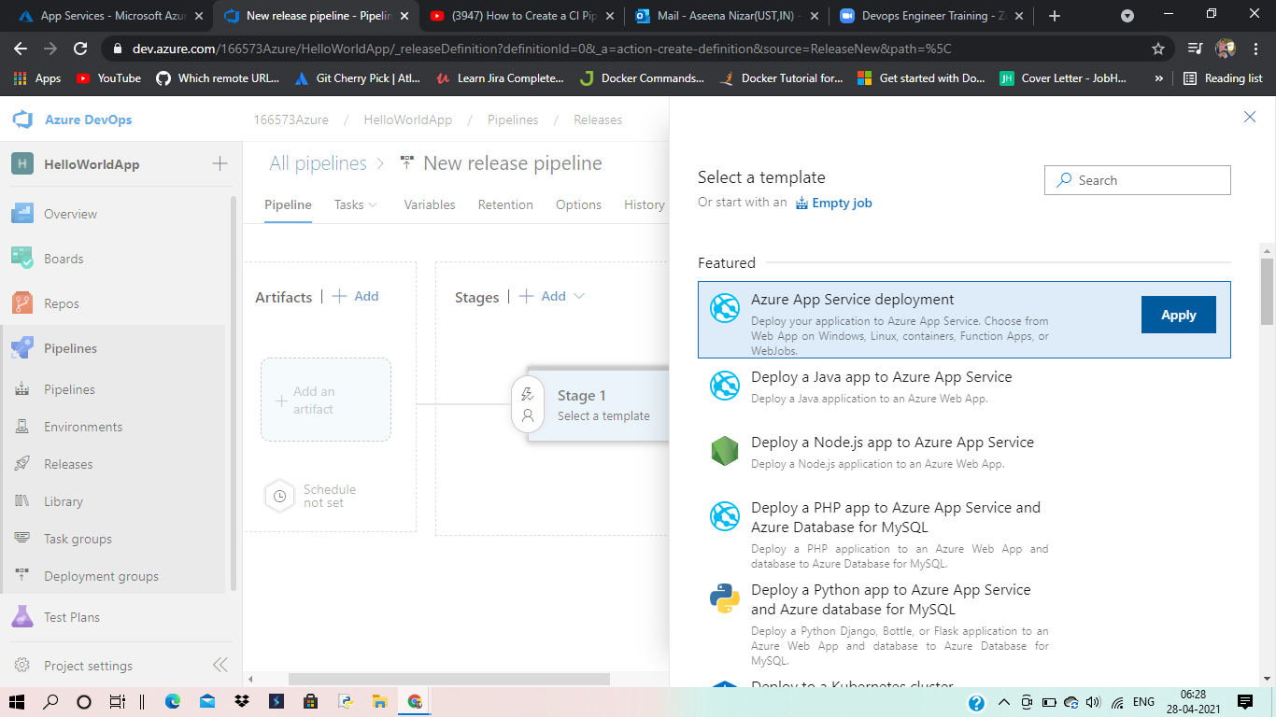

Slide 19
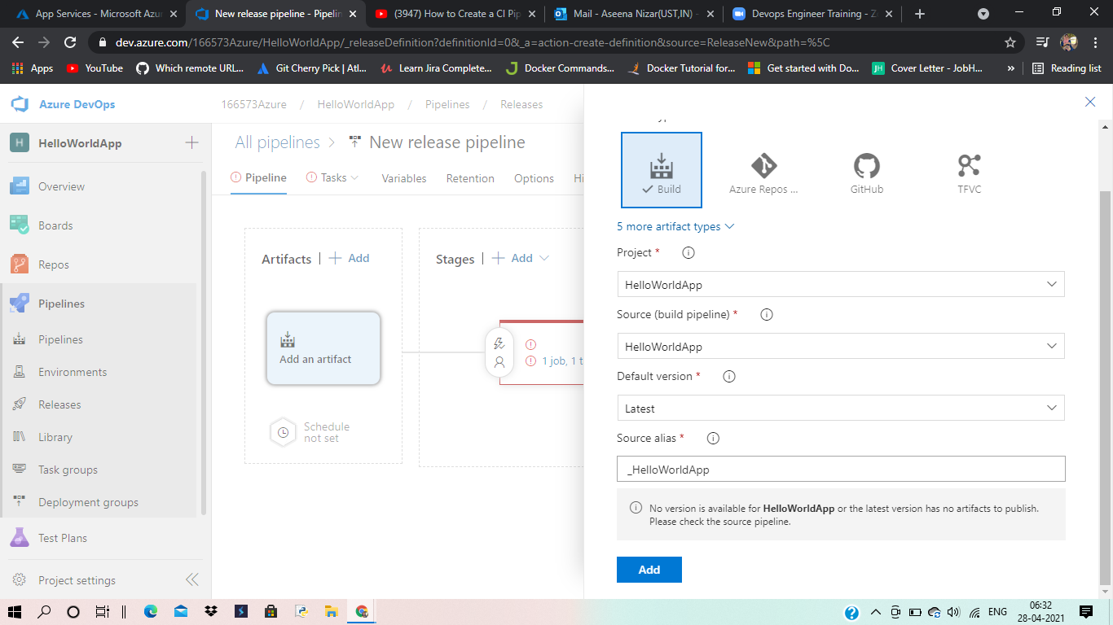

Slide 20
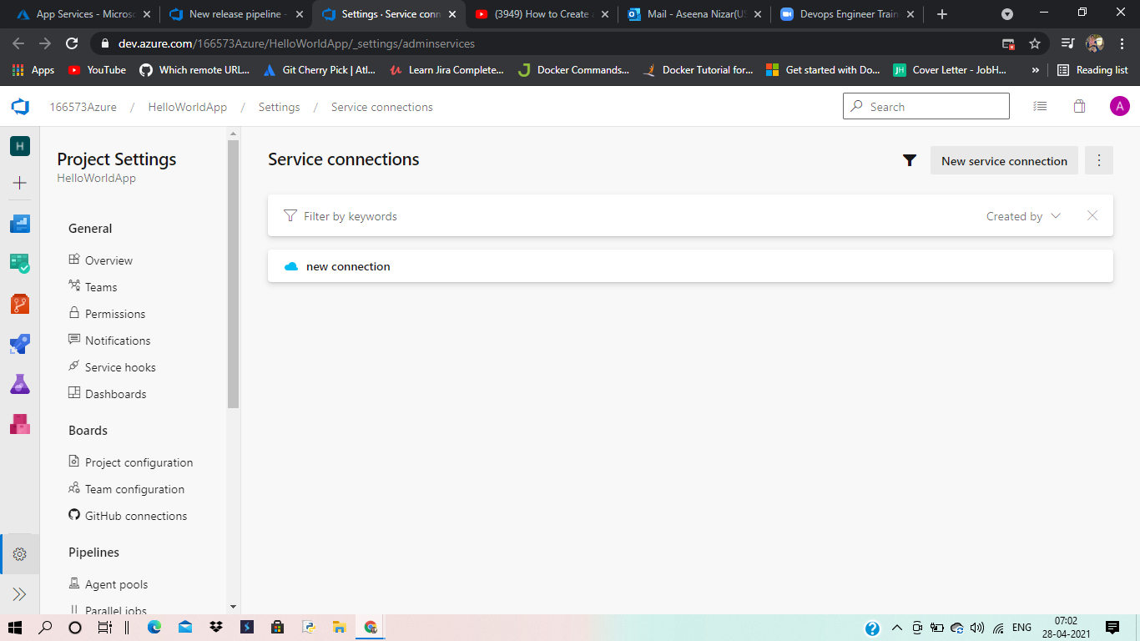

Slide 21
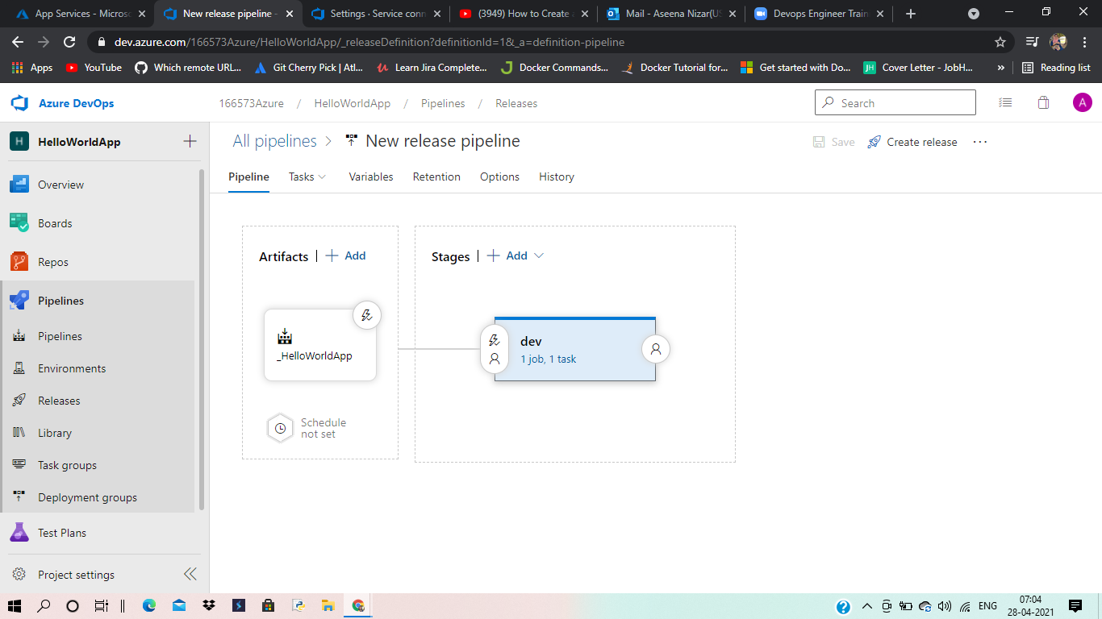

Slide 22
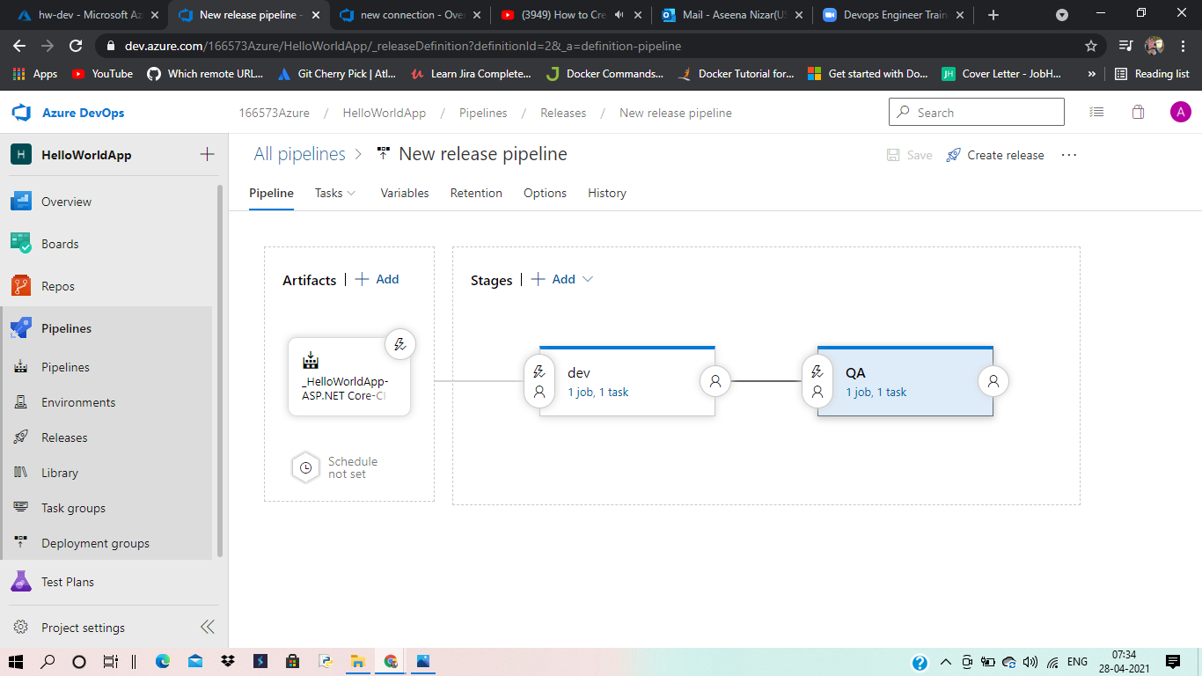

Slide 23
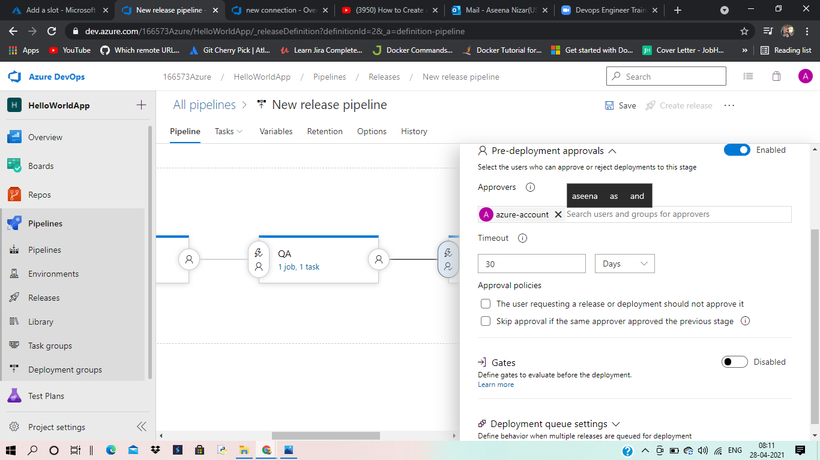

Slide 24
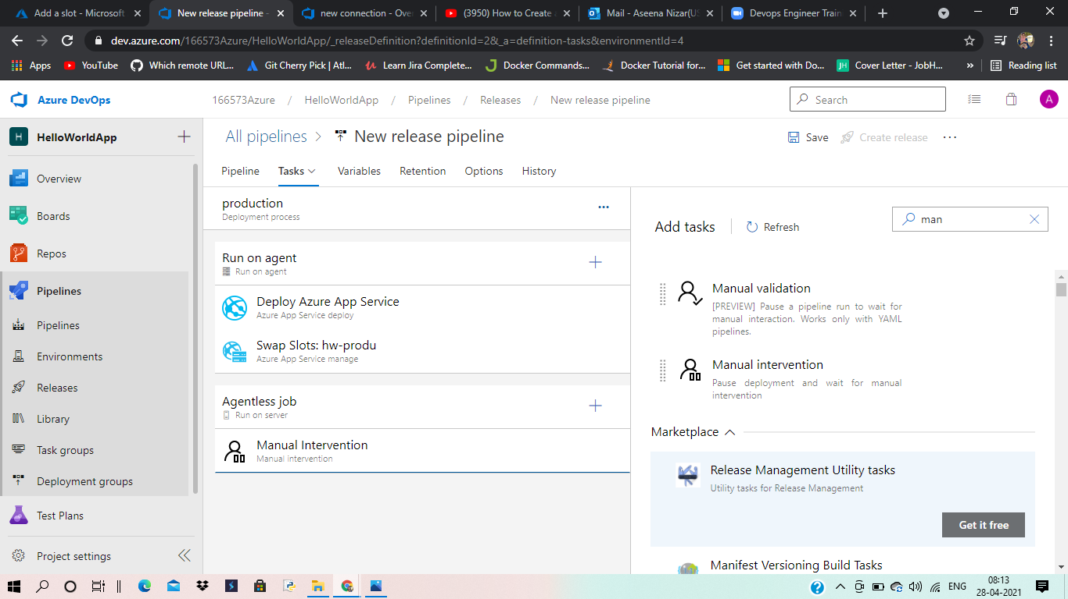

Slide 25
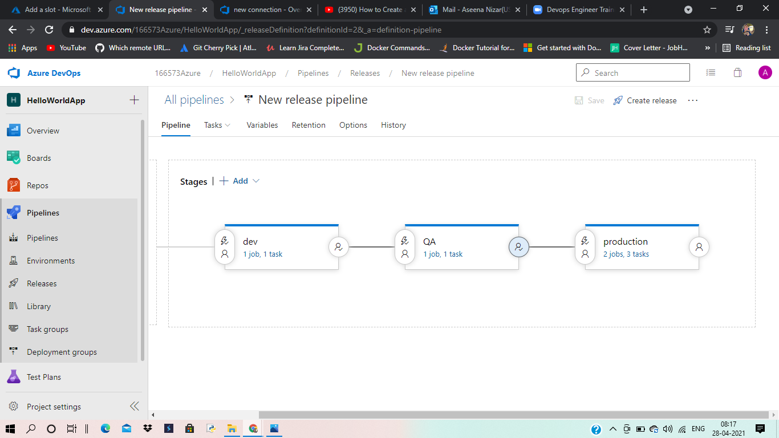

Slide 26
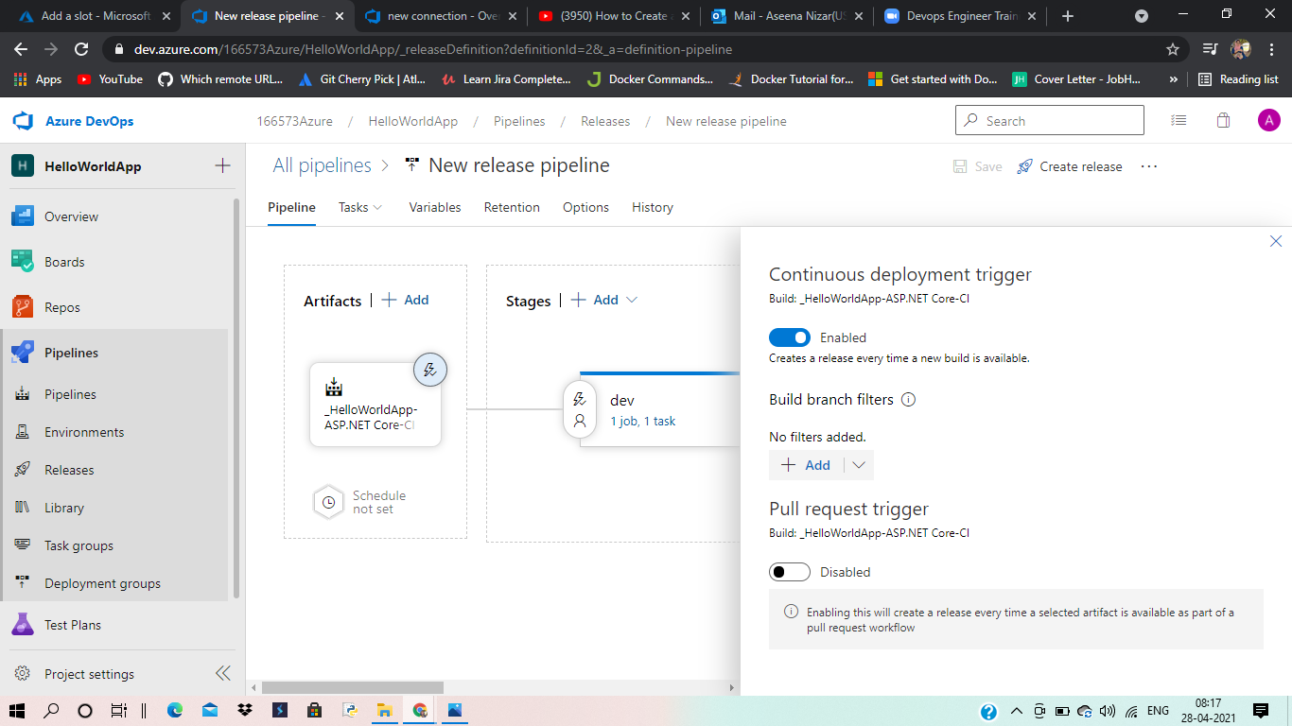

Slide 27
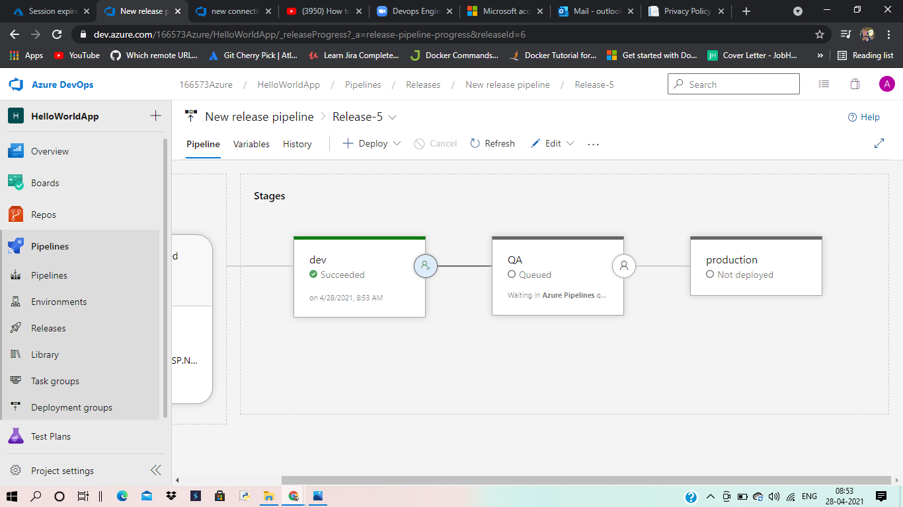

Slide 28
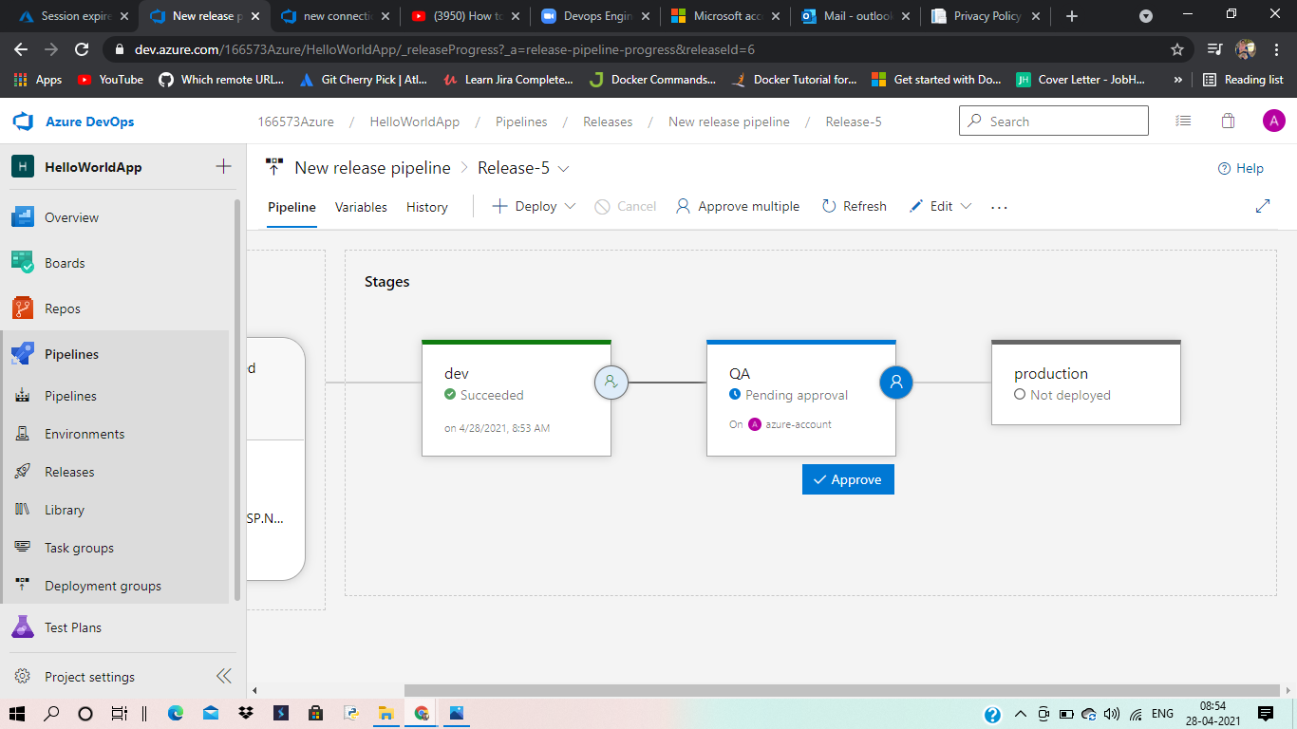

Slide 29
